Slide 1
CLINICAL DECISION MAKING & PATTERN RECOGNITION IN HEALTH CARE
Pavithra Shankar Babu

Slide 2
CONTENTS
Introduction
AI in Diagnosis
Relevant Trends & Opportunities
Strategic Options for Cotiviti
Project Portfolio

Slide 3
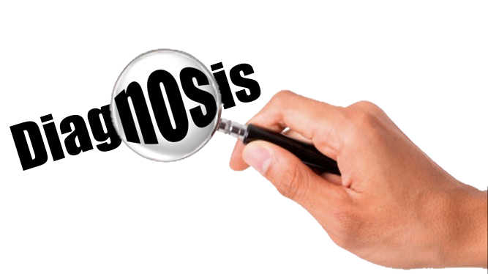
INTRODUCTION
Diagnosis, a cognitive task usually incorporates logical reasoning & pattern recognition.
Accuracy – Pivotal in Health Care & Clinicians failing out there
Solution in AI

Slide 4
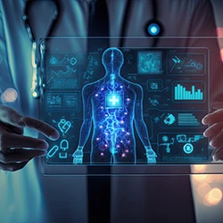
Ai in Diagnosis
Effective tool in Diagnosis
Extensive expedition to incorporate AI
Promising AI driven approaches
Enhanced AI’s predictive performance

Slide 5
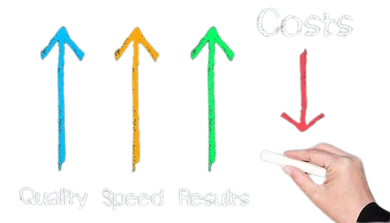
Relevant Trends & opportunities
Integration in Health Care
Open source software Adoption
Improvement in Diagnostic Accuracy
Cost effective implementation
AI driven Healthcare

Slide 6
Strategic options for cotiviti
Develop a specialized AI tool
Partnerships with health care providers
Integration with existing health care systems
Consulting & Customization services

Slide 7
Knowledge is of no value unless you put it into practice
- Anton Chekhov

Slide 8
PROJECT PORTFOLIO
Dentistry
Dentistry
Nephrology
E-Commerce
Banking
A reliable tool to detect the elongation of styloid process
Automatic identification of dental implant systems from digital intraoral periapical radiographs
Detection of Renal Calculi using Convolutional Neural Networks & Image Processing
E-Commerce Orders Analysis & Prediction using KNN and featured algorithms
Loan Eligibility Prediction using Supervised Learning (KNN, Logistic Regression, Naïve Bayes, SVM)

Slide 9
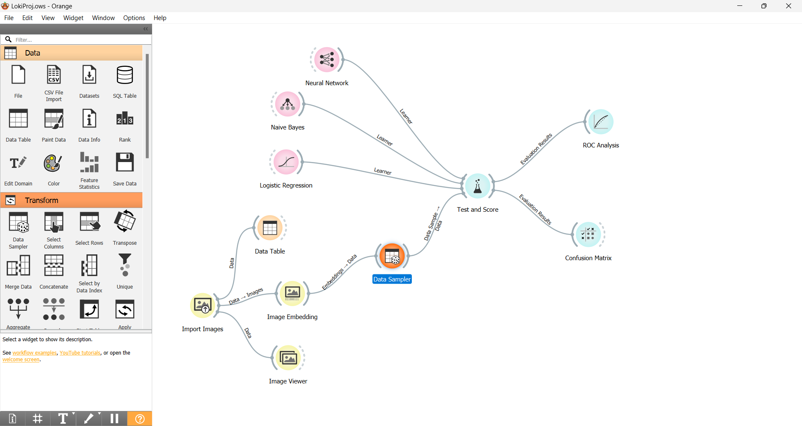
Automatic identification of dental implant systems from digital intraoral periapical radiographs
The workflow involved the use of the Orange Software, an open-source data visualization AI tool, which supports various data processing and ML tasks, including data loading, transformation, visualization with user interaction, model inference, and model visualization
The findings of the study demonstrated that logistic regression and neural network algorithms have the highest accuracy in detecting elongated styloid processes.
Also, the Naïve Bayes algorithm model showed a fairly considerable performance in the classification.

Slide 10
Other Projects
Loan Prediction
Orders Analysis
Dentistry
Implemented various algorithms including K-Nearest Neighbors (KNN), Support Vector Machines (SVM), Logistic Regression, Linear Regression, Naive Bayes, and Gradient Descent.
Implemented KNN and featured algorithms for predicting a order’s delivery and previous analysis.
Using Orange Software, classifications of styloids have been implemented.
Logistic Regression
KNN
Gradient Descent
Data Science & AI
(Classification & Prediction)
Naïve Bayes
SVM

Slide 11
THANK YOU
Pavithra Shankar Babu​
pavithrashankarbabu2000@gmail.com
https://github.com/Pavithra-Shankarbabu?tab=repositories

